Slide 1

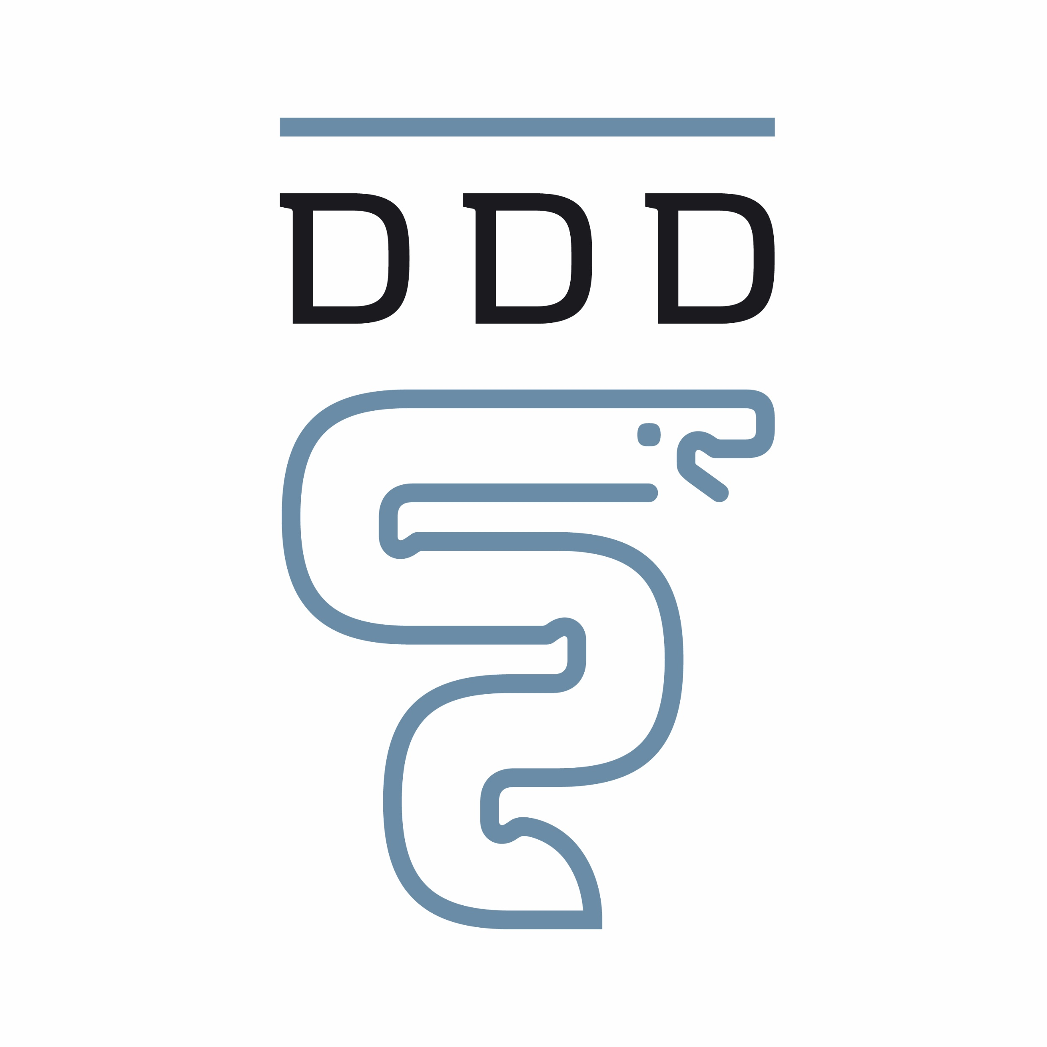



Healthy dog breeding in Denmark
Together we will ensure healthy breeding of Danish dogs
We welcome that a broad majority in the Danish Parliament has decided to set a new framework for breeding requirements for dogs.
To ensure that we breed the healthiest dogs with the best possible starting point for a good life, we propose a model for breeding dogs in Denmark, based on the following values:
1
Health and welfare are more important than a specific physical appearance
4
A registry for dogs' possible diseases and health status
2
Physical health is required when breeding dogs
5
Equal terms for commercial and private dog breeding
3
Welfare is required for the breeding dogs and their progeny
6
Focus on healthy dogs
- also concerning imports
Dansk Kennel Klub
Den Danske Dyrlægeforening
Dyrenes Beskyttelse
DyreværnsOrganisationernes SamarbejdsOrganisation
Dyreværnet

Slide 2
1
Health and welfare are more important than a specific physical appearance
The interest in dogs with short noses, big eyes and small heads, for example, should not result in the breeding of unhealthy dogs. However, dogs with these traits can be healthy if they are bred correctly.
4
A registry for dogs' possible diseases and health status
All dogs must be registered in a public registry with their health requirements and current test results.
The public registry will be accessible to all dog owners in Denmark - and it should be possible to look up breeding requirements and health results for all dog breeds in the registry.
2
Physical health is required when breeding dogs
A dog should pass required health tests prior to breeding. This will create a breeding culture where dogs are bred to move freely, have normal vision, breathe freely, be in good health and give birth without hindrance.
There are already good international results from implementing various tests - such as breathing tests (like BOAS), X-rays and DNA testing (for genetically inherited diseases) –improving health for future generations of dogs.
5
Equal terms for commercial and private dog breeding
Upcoming EU-regulations will set rules for commercial dog breeding that will only apply to around 50% of Danish dog breeding. Current rules should cover all dog breeding in Denmark.
Health and good animal welfare should be equal for all Danish dogs.
6
Focus on healthy dogs - also concerning imports
We want to create international focus on the fact that we in Denmark make demands regarding health and welfare for dogs. By focusing positively on dog health and establishing requirements for breeding processes, we create an understanding of, and demand for healthy dogs. The goal is to reduce the demand for dogs imported from illegal and unhealthy puppy suppliers and instead create the foundation for import of healthy dogs to Denmark.
3
Welfare is required for the breeding dogs and their progeny
Dogs need to be able to mate and give birth naturally.
A bitch that is both physically and mentally mature has the best chance of labouring through pregnancy, birth and caring for the litter of puppies.
A minimum and maximum age must be set for the bitch's first and last litter. There should also be a maximum number of litters for the bitch, and a minimum length of time between litters.
Health and welfare
The Danish dog model
A set of rules with requirements for health tests and animal welfare. A ban on breeding dogs with hereditary illnesses and unnecessarily stressful traits.
Healthier dogs in every generation.
Focus on welfare in breeding processes.
Full support from all interest organizations concerning dogs.
The Norwegian dog model
Ban on breeding dogs with hereditary and unnecessarily burdensome traits.
The Dutch dog model
Prohibition model that incentivizes imports.

